Slide 1
Corporate Overview
2022

Slide 2
Cautionary Note Regarding Forward-looking Statements
The statements in this presentation relating to matters that are not historical facts are forward-looking statements. These forward-looking statements are based upon assumptions of management of LyondellBasell which are believed to be reasonable at the time made and are subject to significant risks and uncertainties. When used in this presentation, the words “estimate,” “believe,” “continue,” “could,” “intend,” “may,” “plan,” “potential,” “predict,” “should,” “will,” “expect,” and similar expressions are intended to identify forward-looking statements, although not all forward-looking statements contain such identifying words. Actual results could differ materially based on factors including, but not limited to, market conditions, the business cyclicality of the chemical, polymers and refining industries; the availability, cost and price volatility of raw materials and utilities, particularly the cost of oil, natural gas, and associated natural gas liquids; uncertainties and impacts related to the extent and duration of the pandemic; competitive product and pricing pressures; labor conditions; our ability to attract and retain key personnel; operating interruptions (including leaks, explosions, fires, weather-related incidents, mechanical failure, unscheduled downtime, supplier disruptions, labor shortages, strikes, work stoppages or other labor difficulties, transportation interruptions, spills and releases and other environmental risks); the supply/demand balances for our and our joint ventures’ products, and the related effects of industry production capacities and operating rates; our ability to manage costs; future financial and operating results; benefits and synergies of any proposed transactions; our ability to identify, evaluate and complete any strategic alternative related to the refinery; legal and environmental proceedings; tax rulings, consequences or proceedings; technological developments, and our ability to develop new products and process technologies; our ability to meet our sustainability goals, including the ability to operate safely, increase production of recycled and renewable-based polymers, and reduce our emissions and achieve net zero emissions by the time set in our respective goals; our ability to procure energy from renewable sources; potential governmental regulatory actions; political unrest and terrorist acts; risks and uncertainties posed by international operations, including foreign currency fluctuations; and our ability to comply with debt covenants and to amend, extend, repay, redeem, service, and reduce our debt. Additional factors that could cause results to differ materially from those described in the forward-looking statements can be found in the “Risk Factors” section of our Form 10-K for the year ended December 31, 2021, which can be found at www.LyondellBasell.com on the Investor Relations page and on the Securities and Exchange Commission’s website at www.sec.gov. There is no assurance that any of the actions, events or results of the forward-looking statements will occur, or if any of them do, what impact they will have on our results of operations or financial condition. Forward-looking statements speak only as of the date they were made and are based on the estimates and opinions of management of LyondellBasell at the time the statements are made. LyondellBasell does not assume any obligation to update forward-looking statements should circumstances or management’s estimates or opinions change, except as required by law.
This presentation contains time sensitive information that is accurate only as of the date hereof. Information contained in this presentation is unaudited and is subject to change. We undertake no obligation to update the information presented herein except as required by law.

Slide 3




LyondellBasell is a strong, global company delivering outstanding performance
LEADING⁽¹⁾
DIVERSE
Producer of polypropylene compounds globally
Licensor of polyolefin technologies globally
Producer of polyethylene in Europe
Producer of polypropylene in Europe
Producer of oxyfuels in Europe and North America
The company's products, materials and technologies are advancing sustainable solutions for food safety, access to clean water, healthcare and fuel efficiency in more than 100 international markets.
GLOBAL
GROWING
Improved reliability of our first world-scale Hyperzone HDPE plant
Expanded in China with integrated cracker JV and PO/SM JV
Expanded in North America with Louisiana Integrated PE JV
Building the world’s largest PO/TBA plant
Launched our Circulen portfolio of polymers that provide circular and sustainable solutions
Every day, our employees work around the clock to safely advance solutions to our world’s biggest challenges.
As a leader in the global chemical industry, LyondellBasell strives every day to be the safest, best operated and most valued company in our industry.
Source: LyondellBasell and IHS Markit. Note: Product rankings are as of December 31, 2021.

Slide 4
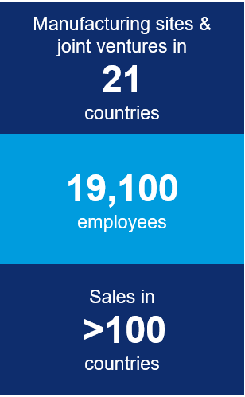
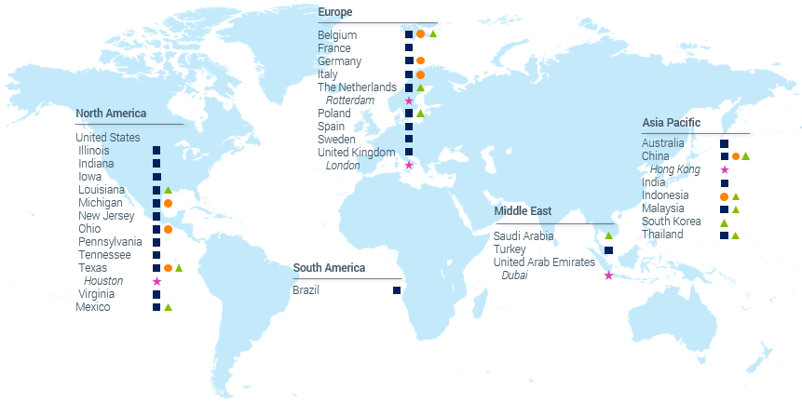
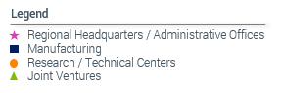
LyondellBasell has the scope and scale to serve global markets
Note: Information as of December 31, 2021.

Slide 5
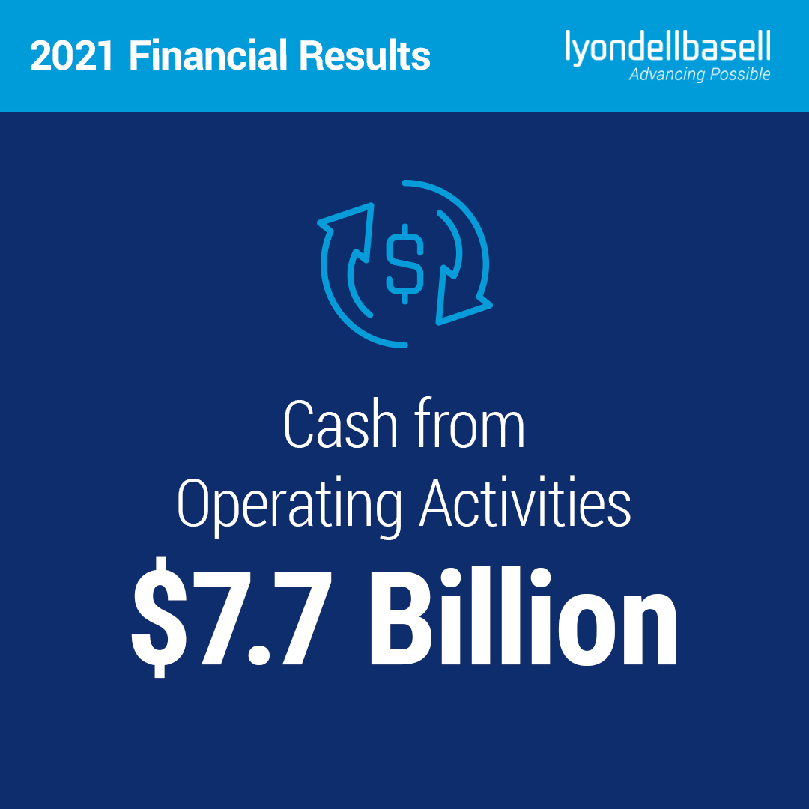
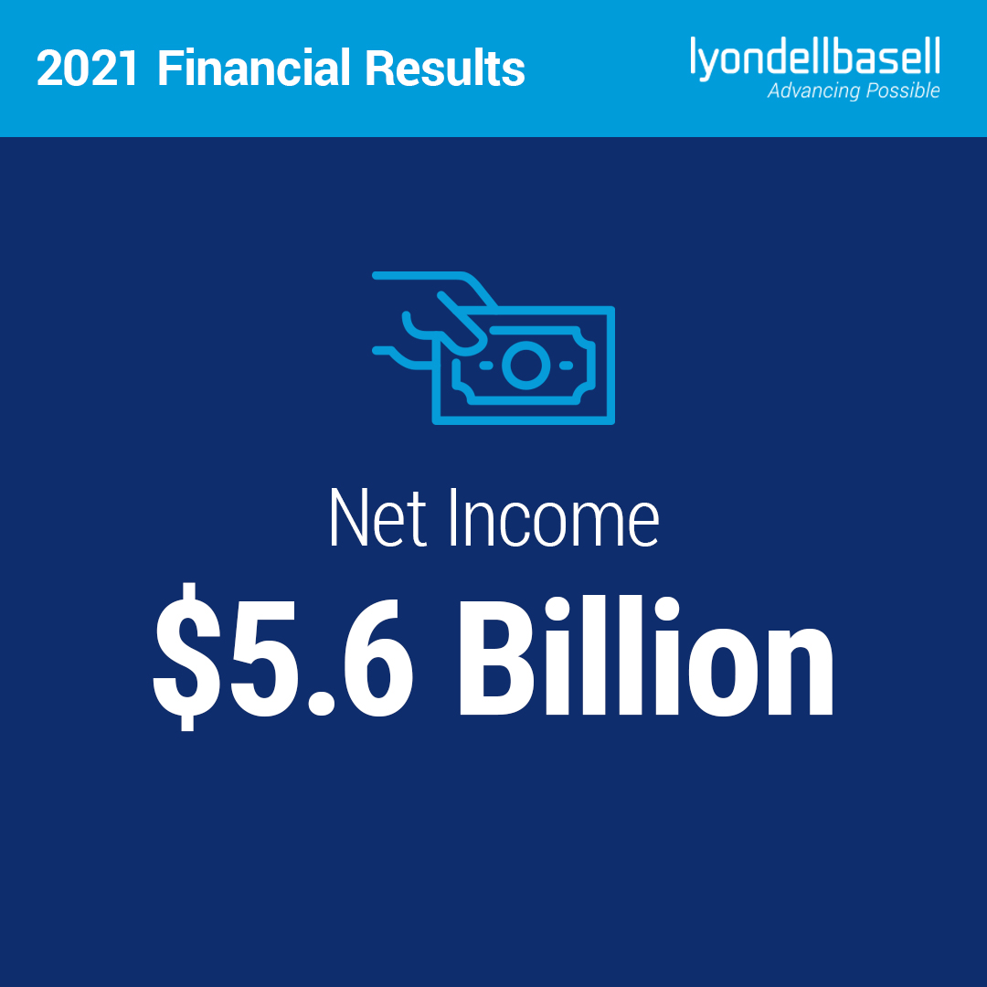
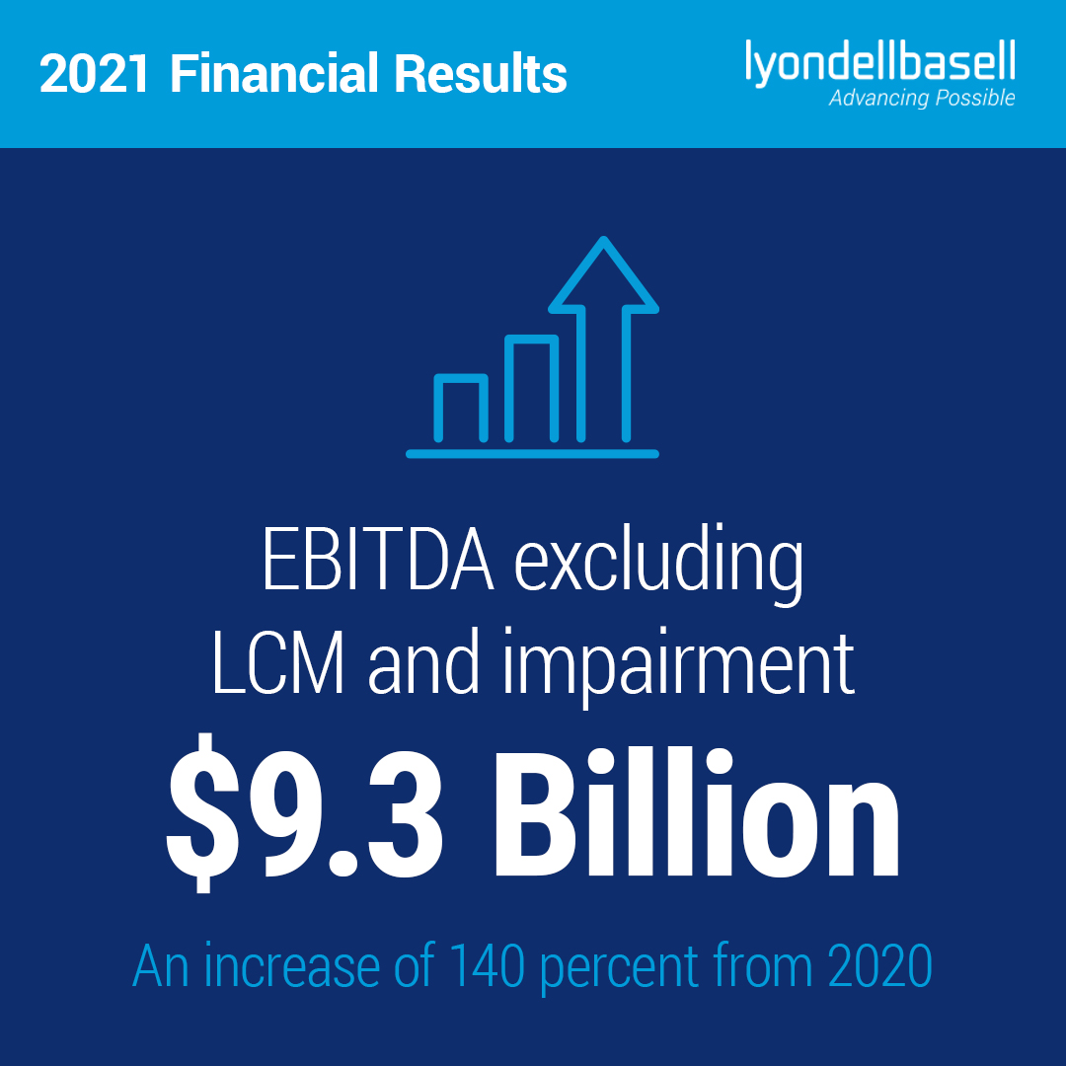
Our 2021 results reflect the robust demand for our products, supply constraints across our industry and our growth investments

Slide 6
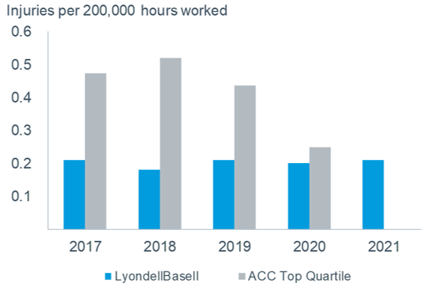
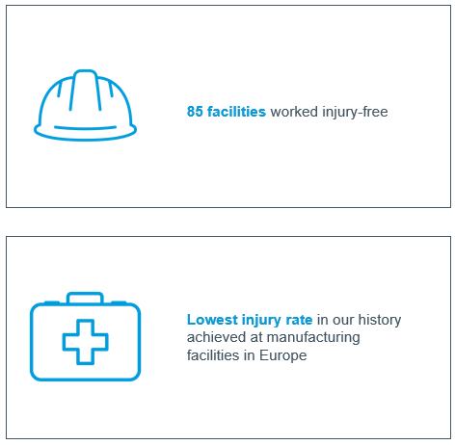
LyondellBasell operates some of the safest, most reliable facilities in the industry
LYB Total Recordable Incident Rate⁽¹⁾
2021 GoalZERO Safety Performance
Source: American Chemistry Council (ACC) and LyondellBasell. Note: Medium and large companies only. Number of hours worked includes employees and contractors. Data includes safety performance from the acquisition of A. Schulman from August 21, 2018 forward.

Slide 7
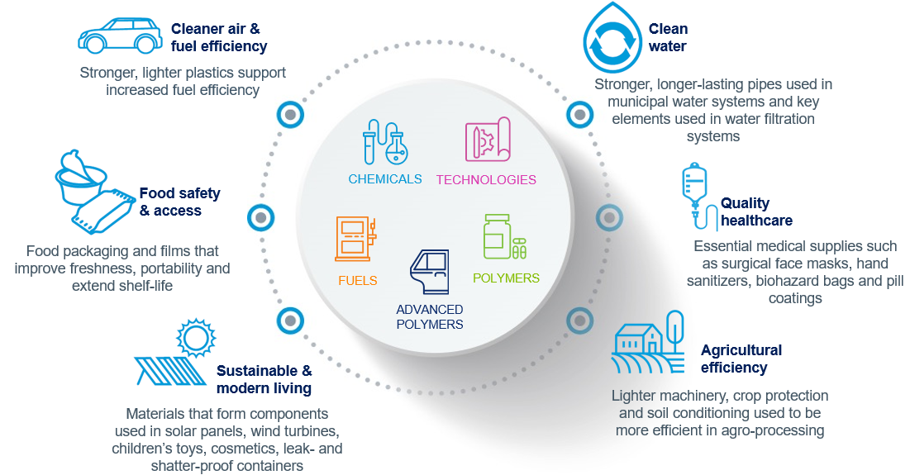
LyondellBasell products are advancing a range of solutions in nearly every geography and sector of the economy

Slide 8
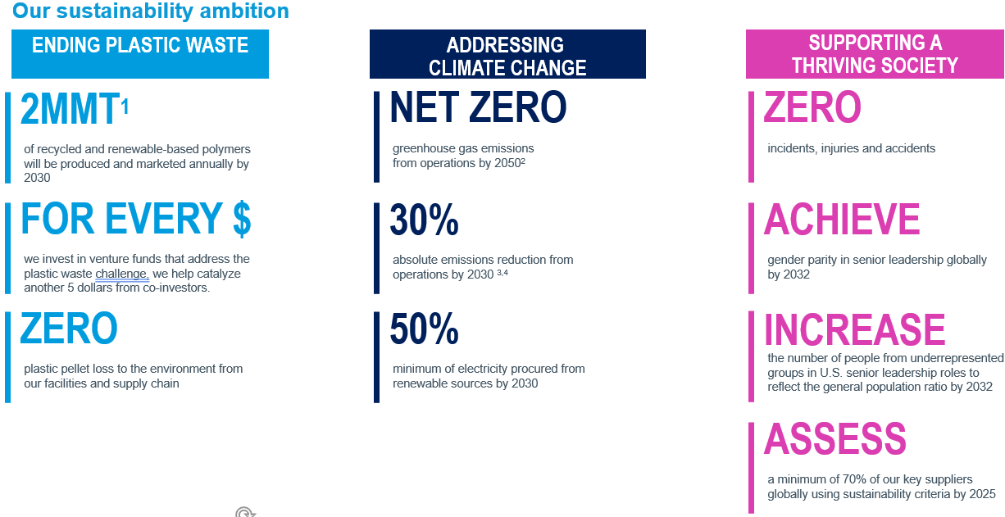
LyondellBasell is working to make meaningful progress to address some of the world’s most pressing challenges
¹ 2 millions metric tons
² Our 2050 net zero goal includes scope 1 and 2 emissions
³ Our 2030 goal includes scope 1 and 2 emissions
⁴ Related to 2020 levels

Slide 9
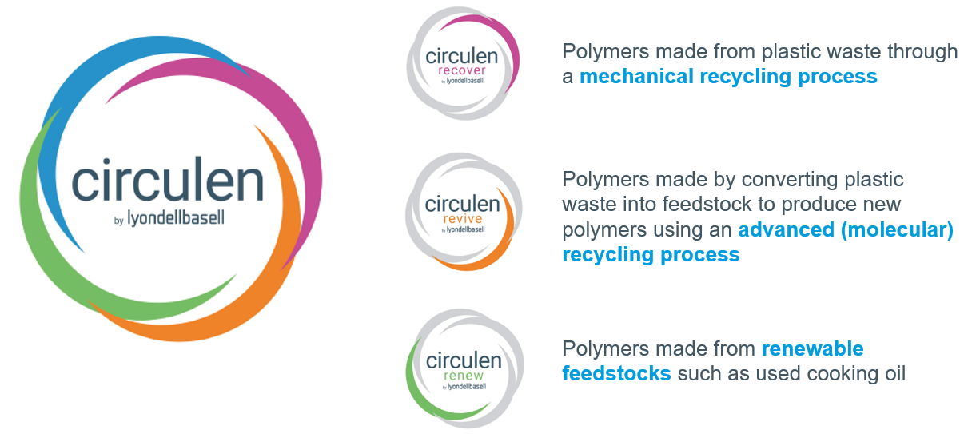
LyondellBasell’s suite of Circulen products enables brand owners to improve the sustainability of consumer products

Slide 10

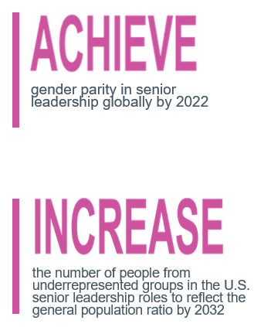

Diversity, Equity & Inclusion are key drivers to achieving our business and sustainability ambitions

Slide 11
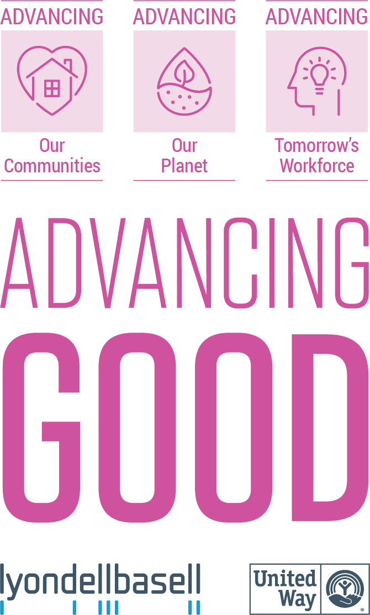
2021 Advancing Good By The Numbers
$11MM
contributed globally through 1,300 grants
$1.1MM
raised for United Way campaign by employees with a 1:1 company match
$1MM
For emergency relief and first responder support
24 tons
trash collected in local communities
$540K
matched through 930 employee requests
350K gallons
of rainwater conserved
10,600 hours
employees spend volunteering
1,600 pieces
of equipment recycled to prevent e-waste
570 projects
funded at U.S. public schools; 83% supported equity focused schools
$300K
value of volunteer hours served*
*28.54/hr.; site reference: https://nlctb.org/tips/value-of-volunteer-time/

Slide 12
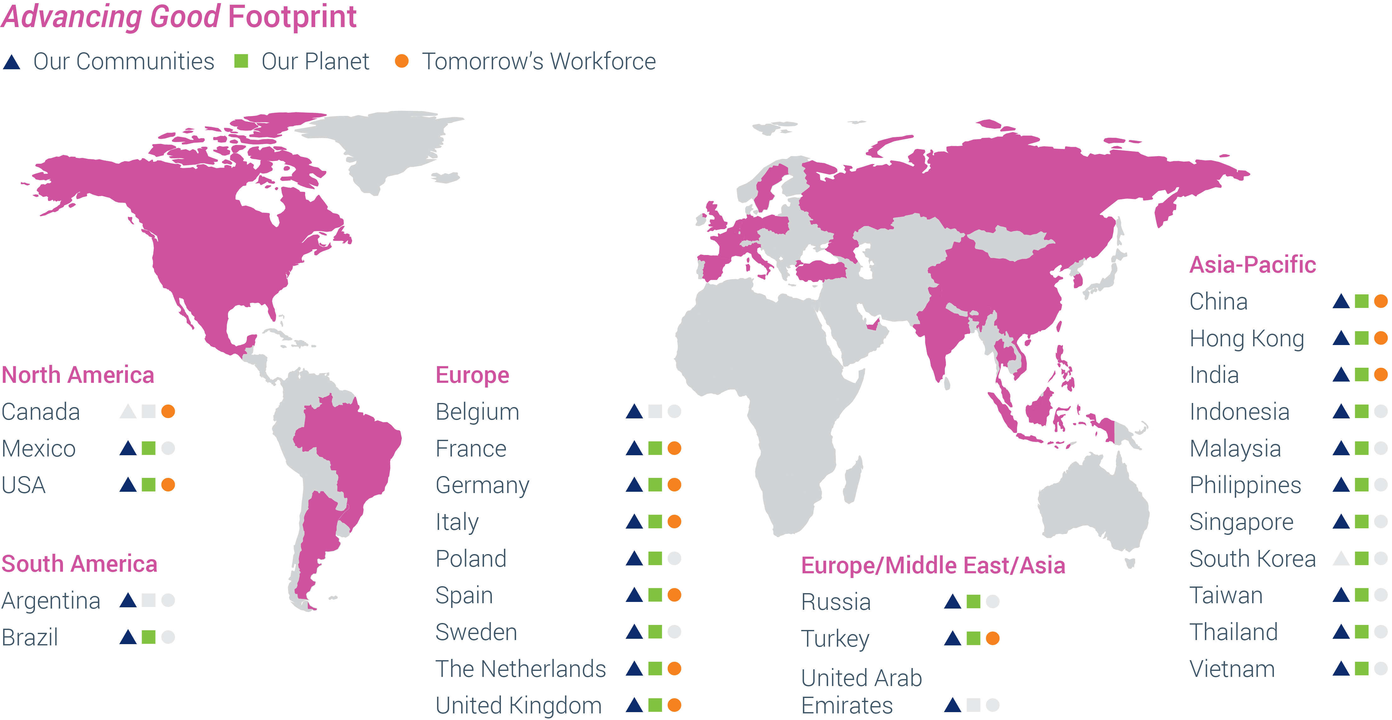





Our Global Advancing Good Footprint

Slide 13
Challenge: Don’t run out of Resources!
LYB’s team has encountered a few issues when developing Field Applications for Autonomous and Personal Devices off-world!
Do you have what it takes to accompany them in their odyssey and help these Devices find their way back to home?

Slide 14
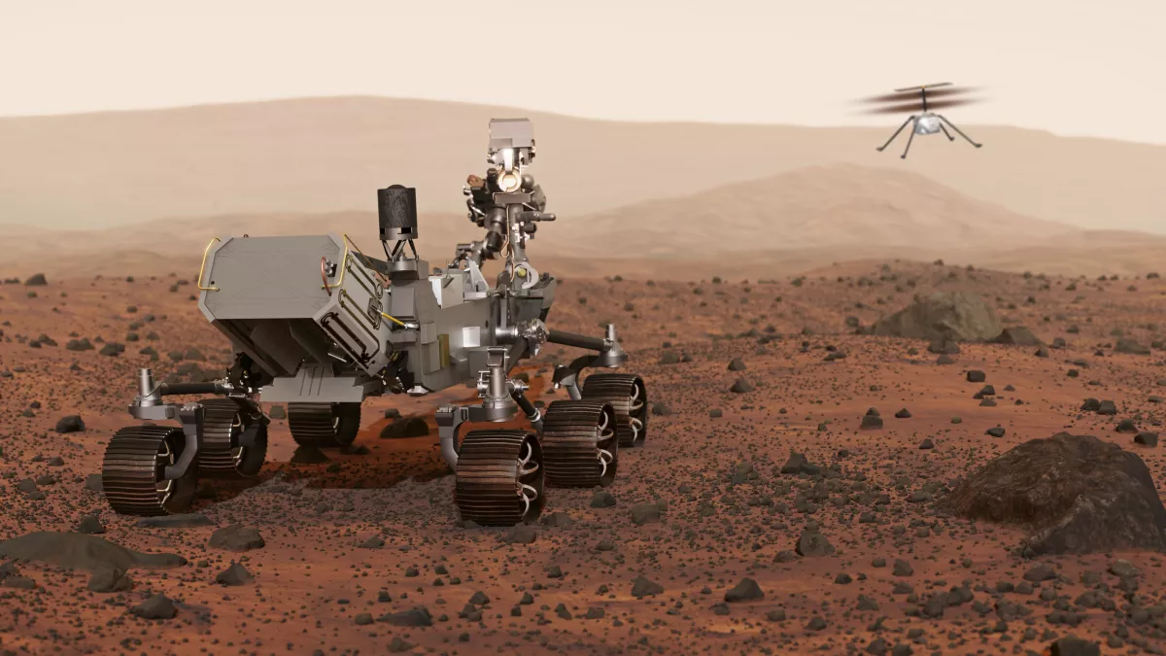




Challenge: Don’t run out of Resources!
Coordinates: 23.45, 34.56
Power: 26%
Available Storage: 56%
Wi-Fi Availability: None

Slide 15
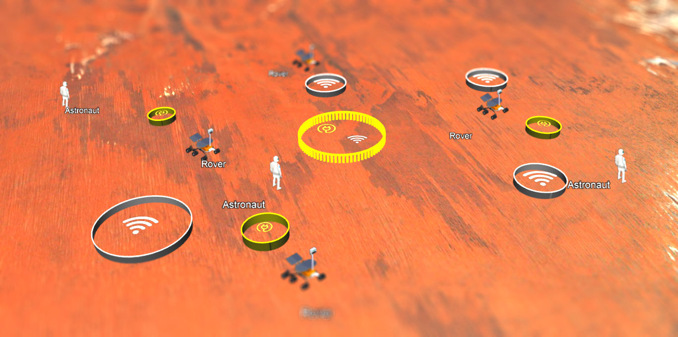
Challenge: Don’t run out of Resources!

